Slide 1

Software Testing

Slide 2
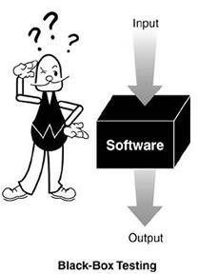
Specification Based Testing

Slide 3
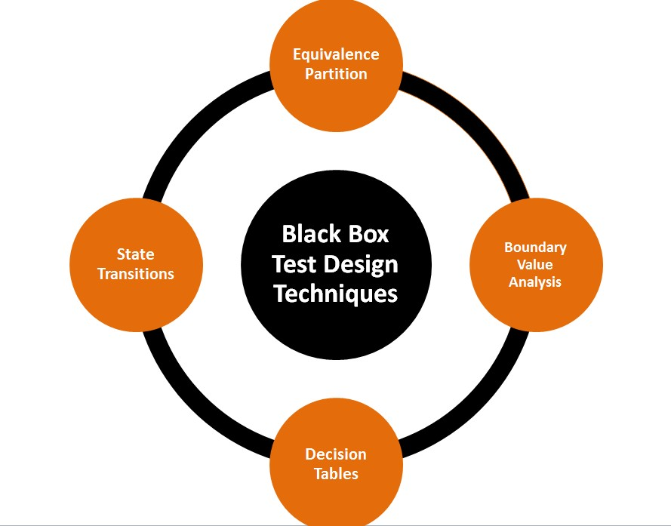
Black Box – Test Design Techniques

Slide 4
Black –Box : Equivalence Partitioning
Equivalence partitioning | or | Equivalence
Class partitioning (ECP) | is | a software
testing technique that divides the input data of a software unit into partitions of equivalent data from which test cases can be derived.

Slide 5
Black –Box : Equivalence Partitioning
Invalid
Valid
Invalid
Assumption :
If one value works, all will work

Slide 6
Black –Box : Equivalence Partitioning
Example - 01:
Assume that the application accepts an integer in the range 100 to 999
Valid Equivalence Class partition: 100 to 999 inclusive.
Non-valid Equivalence Class partitions: less than 100, more than 999, decimal numbers and alphabets/non- numeric characters.

Slide 7
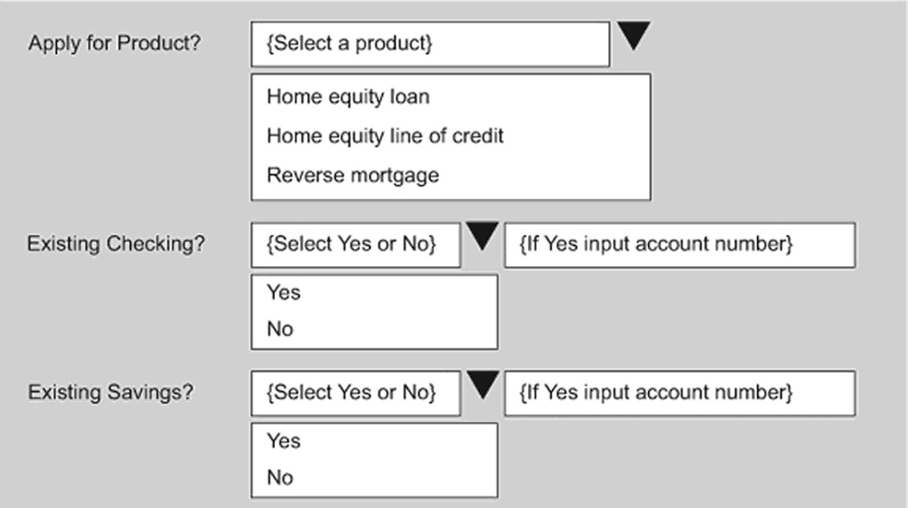
Black –Box : Equivalence Partitioning

Slide 8
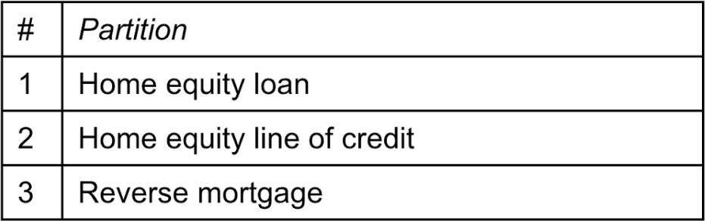
Black –Box : Equivalence Partitioning
Example – 02:
Equivalence Partition : Product

Slide 9
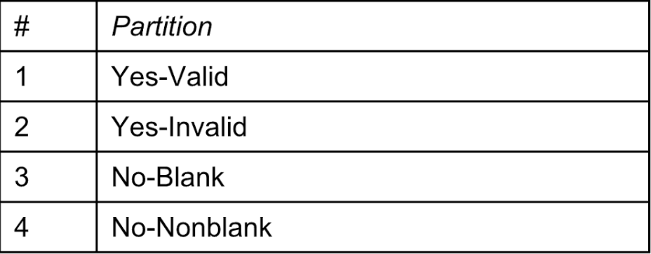
Black –Box : Equivalence Partitioning
Example – 02:
Equivalence Partition : Checking Account Information

Slide 10
Black –Box : Equivalence Partitioning
Example – 02:
Equivalence Partition : Existing Savings Account Information

Slide 11
Black –Box : Equivalence Partitioning
Example – 02:
Test Cases:
Inputs | 1 | 2 | 3 | 4
Product | HEL | LOC | HEL | RM
Existing Checking | YES | NO | YES | NO
Checking Account | VALID | BLANK | INVALID | NONBLANK
Existing Savings | NO | YES | YES | YES
Savings Account | BLANK | INVALID | VALID | NONBLANK
Output
Accept ? | YES | NO | NO | NO
Error ? | NO | YES | YES | YES

Slide 12
Black –Box : Boundary Value Analysis
Testing at the boundaries between partitions
Behavior at the edge of each equivalence partition is more likely to be incorrect than behavior within the partition, so boundaries are an area where testing is likely to yield defects. The maximum and minimum values of a partition are its boundary values. A boundary value for a valid partition is a valid boundary value; the boundary of an invalid partition is an invalid boundary value. Tests can be designed to cover both valid and invalid boundary values. When designing test cases, a test for each boundary value is chosen

Slide 13
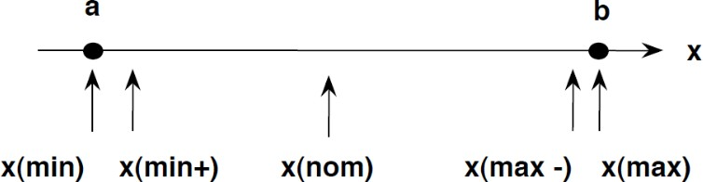
Black –Box : Boundary Value Analysis
Testing at the boundaries between partitions

Slide 14
Black –Box : Boundary Value Analysis
Example 01 :
A store in city offers different discounts depending on the purchases made by the individual. In order to test the software that calculates the discounts, we can identify the ranges of purchase values that earn the different discounts. For example, if a purchase is in the range of $1 up to $50 has no discounts, a purchase over
$50 and up to $200 has a 5% discount, and purchases of $201 and up to $500 have a 10% discounts, and purchases of $501 and above have a 15% discounts.

Slide 15
Answer
Equivalence Partitions:
$0 < $50 -> 0% discount
$50 - $200 -> 5% discount
$200 - $500 -> 10% discount
>$500 -> 15% discount
BVAs:
$49.99, $50, $50.01 …

Slide 16
Example 02 :
Condition | Valid partitions | Invalid partitions | Valid boundaries | Invalid boundaries
Account number | 6 digits | <6 digits | 100000 | 5 digits
 | 1st digit non-zero | >6 digits | 999999 | 7 digits
 |  | 1st digit = 0 |  | 0 numbers / alphabet + Special chars
 |  | Non -Number | 100 000 – 999 999
Account number field: 6 digits, 1st digit should be a non-zero

Slide 17
Equivalence Partition + Boundary Value Analysis
Password Validation
6-10 Character Alphanumeric

Slide 18
Answer
Password Validation : 6-10 Character Alphanumeric
Equivalence Partitions:
BVAs:
Notes:
Valid : Alphabet + Numbers only , Pwd size should 6 – 10 characters
Invalid : less than 6 chars , More than 10 chars, Only alphabet , Only numbers, Having special characters

Slide 19
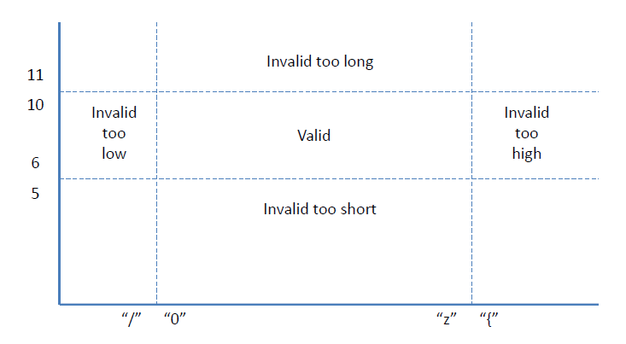
Password Validation
6-10 Character Alphanumeric

Slide 20
Black –Box : Decision Tables
Decision tables are a precise yet compact way to model complex rule sets and their corresponding actions.
Explore combinations of inputs, situations or events

Slide 21
Black –Box : Decision Tables
Example -01 :
Withdrawal is granted if requested amount is covered by the balance or if the customer is granted credit to cover the withdrawal amount

Slide 22
Black –Box : Decision Tables
Example -01 :
Withdrawal is granted if requested amount is covered by the balance or if the customer is granted credit to cover the withdrawal amount
Condition | Rule 1 | Rule 2 | Rule 3 | Rule 4
Withdraw Amount < = Balance | T | T | F | F
Credit Facility Granted | T | F | T | F

Slide 23
Black –Box : Decision Tables
Example -01 : Contd.
Condition | Rule 1 | Rule 2 | Rule 3 | Rule 4
Withdraw Amount < = Balance | T | T | F | F
Credit Facility Granted | T | F | T | F
Action
Withdrawal Granted | T | T | T | F

Slide 24
Black –Box : Decision Tables
Example -01 : Contd.
Condition | Rule 1 | Rule 3 | Rule 4
Withdraw Amount < = Balance | T | F | F
Credit Facility Granted | - | T | F
Action
Withdrawal Granted | T | T | F

Slide 25
Black –Box : Decision Tables
Example -01 : Contd. - Test Cases :
Rule 1 : Account Balance 200, Requested Withdrawal = 200,
Expected Result = Withdrawal Granted
Rule 3 : Account Balance 100, Requested Withdrawal = 200, Credit Granted
Expected Result = Withdrawal Granted

Slide 26
Black –Box : Decision Tables
Example -01 : Contd. - Test Cases :
Rule 4 : Account Balance 100, Requested Withdrawal = 200, No Credit Granted Expected Result = Withdrawal Denied

Slide 27
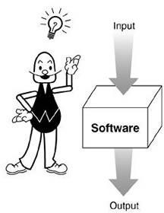
Structure - Based Testing

Slide 28





Statement Testing
Path
Testing
Decision / Branch Testing
White Box Test Design Techniques
MC / DC
Testing
Condition
Testing
Multiple Condition Testing
Condition Decision Testing

Slide 29
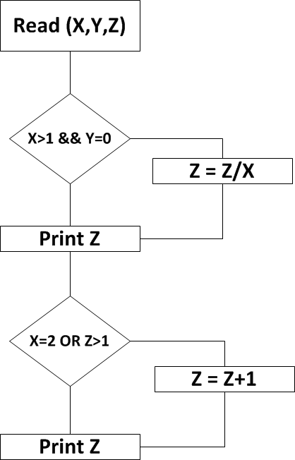
Sample Programme
//get the values for variables X,Y and Z Read (X)
Read (Y) Read (Z)
// decision point 1
If (X>1 && Y=0) then Z = Z/X
endIf
Print (Z)
// decision point 2 If (X=2 OR Z>1) then
Z = Z+1
endIf

Slide 30
Statement Testing
Which involves the execution of all the statements at least once in the source code.
It is a metric, which is used to calculate and measure the number of statements in the source code which have been executed

Slide 31
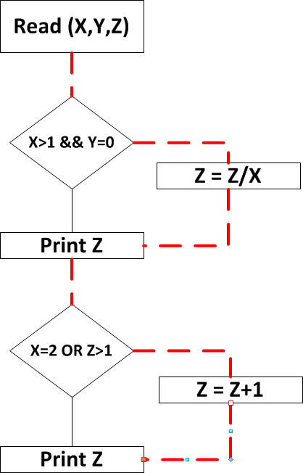
Statement Testing – Example 1
Inputs
X =2 , Y=0, Z=4
Output Z = 2
Output Z = 3

Slide 32
Decision / Branch Testing
Branch coverage is a testing method, which aims to ensure that each one of the possible branch from each decision point is executed at least once and thereby ensuring that all reachable code is executed. That is, every branch taken each way, true and false

Slide 33
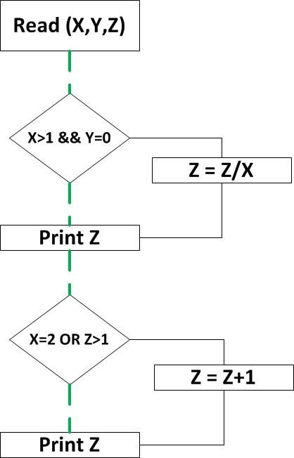
Decision / Branch Testing
Test 1 : X=2 , Y=0, Z=4 Test 2 : X=1 , Y=1, Z=1
Output : Z=2 , Z=3
Output : Z=1 , Z=1

Slide 34
Decision / Branch Testing
Identify data to force execution of decision both ways (TRUE/ FALSE)
100% Decision coverage gives 100% Statement coverage
each
Defects may exists in untested decisions or branches

Slide 35
Condition Coverage
Looks at Atomic Conditions
Each atomic condition should be at least once True and Once False
Condition coverage does not always leads to Decision Coverage

Slide 36
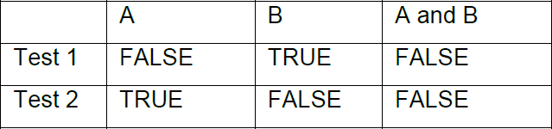
Condition Coverage
Example: 01

Slide 37
Condition Coverage
Example: 02
X > 1 && Y==0
 | X > 1 | Y==0 | Decision
Test 1 | X = 2 | Y=1 | FALSE
Test 2 | X =1 | Y=0 | FALSE
X = 2 OR Z > 1
 | X =2 | Z >1 | Decision
Test 1 | X = 2 | Z=1 | TRUE
Test 2 | X =1 | Z=4 | TRUE
Data Sets : Test 1 : X=2, Y=1, Z=1
Test 2 : X=1, Y=0, Z=4

Slide 38
Decision Condition Coverage
Decision Condition testing specifies that testing must achieve condition coverage and also requires that decision coverage also be satisfied

Slide 39
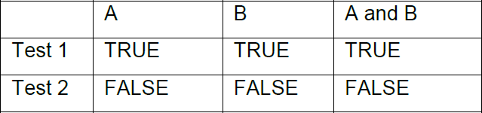
Decision Condition Coverage
Example : 01

Slide 40
Decision Condition Coverage
Example: 02 (Sample Programme – Refer-Slide 42)
X > 1 && Y==0
 | X > 1 | Y==0 | Decision
Test 1 | X = 2 | Y=0 | TRUE
Test 2 | X =1 | Y=1 | FALSE
X = 2 OR Z > 1
 | X =2 | Z >1 | Decision
Test 1 | X = 2 | Z=4 | TRUE
Test 2 | X =1 | Z=1 | FALSE
Data Sets : Test 1 : X=2, Y=0, Z=4
Test 2 : X=1, Y=1, Z=1

Slide 41
Multiple Condition Testing
Test all possible combinations of values that a decision may contain. This exhaustive level of testing is called multiple condition coverage
The number of required tests is dependent on the number of atomic conditions in the decision statement and can be determined by calculating 2^{n} where n is the number of uncoupled atomic conditions

Slide 42
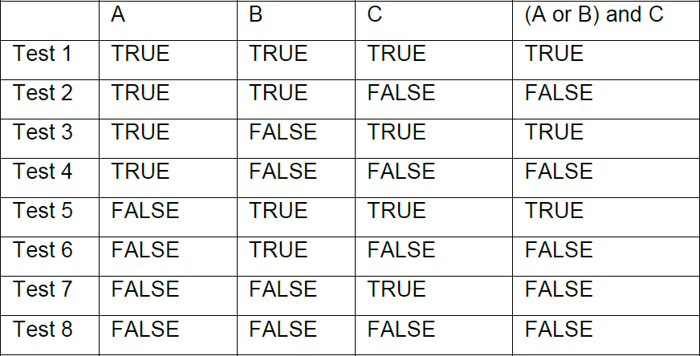
Multiple Condition Testing
Example -01

Slide 43
Multiple Condition Coverage
Example: 02
X > 1 && Y==0
 | X > 1 | Y==0 | Decision | Input Value
Test 1 | TRUE | TRUE | TRUE | X=2 , Y=0
Test 2 | TRUE | FALSE | FALSE | X=2 , Y=1
Test 3 | FALSE | TRUE | FALSE | X=1 , Y=0
Test 4 | FALSE | FALSE | FALSE | X=1 , Y=1
X = 2 OR Z > 1
 | X =2 | Z >1 | Decision | Input Value
Test 1 | TRUE | TRUE | TRUE | X=2 , Z=4
Test 2 | TRUE | FALSE | TRUE | X=2 , Z=1
Test 3 | FALSE | TRUE | TRUE | X=1 , Z=4
Test 4 | FALSE | FALSE | FALSE | X=1 , Z=1
Data Sets : Test 1 : X=2, Y=0, Z=4
Test 2 : X=1, Y=1, Z=1

Slide 44
Path Testing
Path testing consists of identifying paths through the code and then creating tests to cover them. Conceptually, it would be useful to test every unique path through the system. In any non-trivial system, however, the number of test cases could become excessively large due to the nature of looping structures

Slide 45
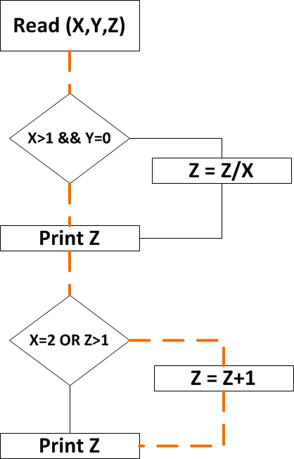
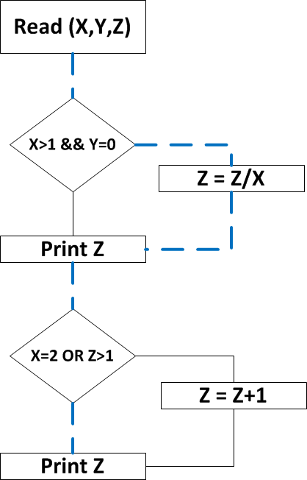
Path Testing - Example
Path - 1
Path - 2
Path - 3
Path - 4

Slide 46
Test cases
Test case id
Unit to test: What to be verified?
Assumptions
Test data: Variables and their values
Steps to be executed
Expected result
Actual result
Pass/Fail
Comments

Slide 47
